Slide 1
Algorithm Analysis
Calculating the Cost of an Algorithm

Slide 2
How to Calculate an Algorithm’s Complexity
To calculate the Big O for an algorithm:
Assess how much each line of your code “costs”
Add the cost of each of the lines together
“Filter” to remove unnecessary information
Big O calculation has some rules:
Always assume the worst
Drop constants
Use different terms/variable names for different inputs to the algorithm
Drop any “non-dominants”

Slide 3
Rule 1: Always Assume the Worst
In Big O, we want to find the WORST performance cost possible
E.g. What is the maximum number of times a loop could run
When calculating the cost of a line of code, think about the worst way it could play out
for(String current: elements){ if(current.equals(e)){ return true; } } return false;
What’s the maximum number of times each of these lines would run?

Slide 4
Rule 1) Calculating…
for(String current: elements){ if(current.equals(e)){ return true; } } return false;
O(n)
O(1)
The loop and the if are O(n) because they will each potentially run once for every element in the array
The returns will each only run once (O(1)), because as soon as you return from a method, the method’s code ends
In other words, you can only ever return from a method once
Additionally, you will only do ONE of these returns
Total cost: O(n) + O(n) + O(1) = O(n + n + 1) = O(2n + 1)
This leads us to rule 2 – drop your constants!

Slide 5
Rule 2) Drop Constants
Constants: Things we know will run a fixed number of times
We ignore/drop constants from our calculations
They are very likely to be insignificant when compared to the cost of the rest of the algorithm’s operations
If you have an array with 5 things, each n operations equates to 5
If you have an array with 50000 things, each n operations equates to 50000
A single fixed instruction doesn’t compare to this jump
Only time we don’t drop constants is when all we have is constants!

Slide 6
Rule 2) Drop Constants (2)
Constants can also be multipliers/coefficients
Previous example included 2n as part of the calculation
Multiplying by 2 doesn’t compare to increasing the number within n
The bigger the number of elements gets, the smaller the impact the multiplier would have
When comparing, we look at things in terms of the number of elements: An algorithm with O(n) is usually better than one with O(n²)
O(2n) isn’t different enough from O(n) to make it worth including

Slide 7
Rule 2) Calculating…
for(String current: elements){ if(current.equals(e)){ return true; } } return false;
All this comes to O(2n+1),
which simplifies to O(n)
We have 2 different constant components in our current example
2: The multiplier on our n value
1: The single instruction
These get dropped from our overall calculation to make it O(n)

Slide 8
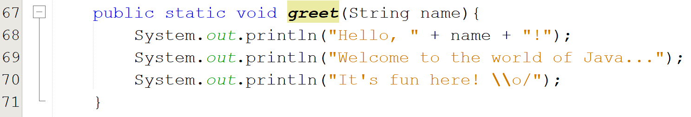
Rule 2) Calculating… (Constants Only)
In this situation, all we have are constants
O(1) + O(1) + O(1) = O(3)
When we apply the “drop constants” rule, we have to simplify this
We can’t just drop all constants, as that would imply this LITERALLY takes no time
Simplified, this changes to O(1)

Slide 9
Rule 3) Use Different Terms for Different Inputs
All algorithms have inputs
If you have a single array, there is one input, giving n elements to work with
If you have two arrays to work with, there are two inputs, giving a + b elements to work with
If you have three arrays to work with, there are three inputs, giving a + b + c elements to work with
If you have separate loops, you add terms
If you have a nested loop, you multiply terms

Slide 10
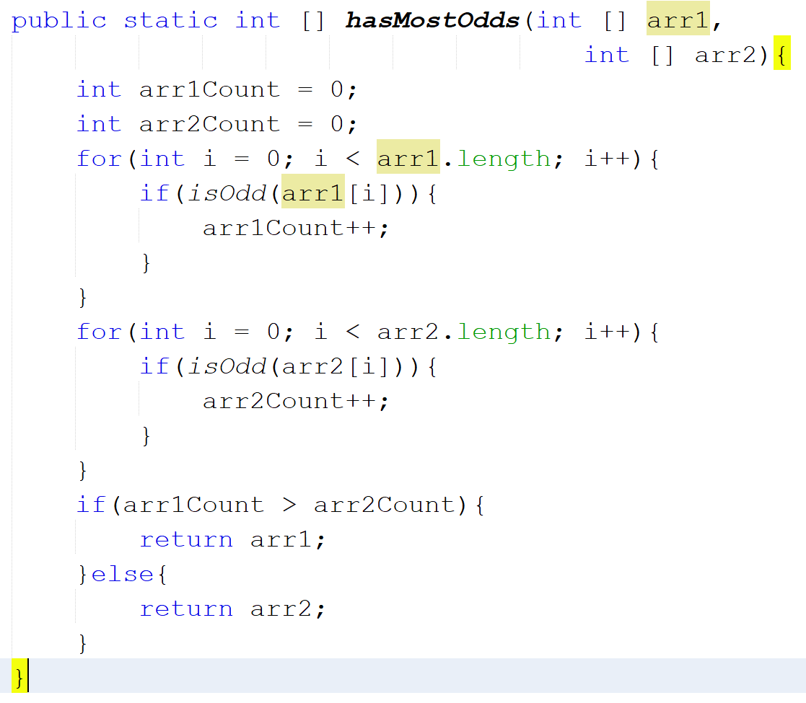
Rule 3) Calculating… For Separate Loops With Different Terms
In this example we have two separate loops
For each loop in an algorithm, we add the terms involved
Term: The number of elements in an array used by the algorithm
Result: O(a+b), where a = arr1.length and b = arr2.length

Slide 11
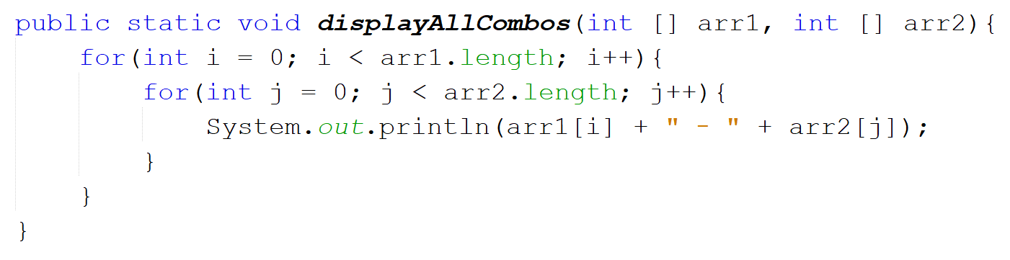
Rule 3) Calculating… For Nested Loops With Different Terms
In this example we have a nested loop
To calculate for a nested loop, we multiply the terms involved
Result: O(a*b), where a = arr1.length and b = arr2.length

Slide 12
Rule 4) Remove All Non-Dominants
When you have the final value calculated for an algorithm, reduce the equation to its largest part
Where you have multiple terms, reduce it to the largest part for each term
The reason? The dominant term is the most impactful
Remember: n² has a much bigger impact on things than n

Slide 13
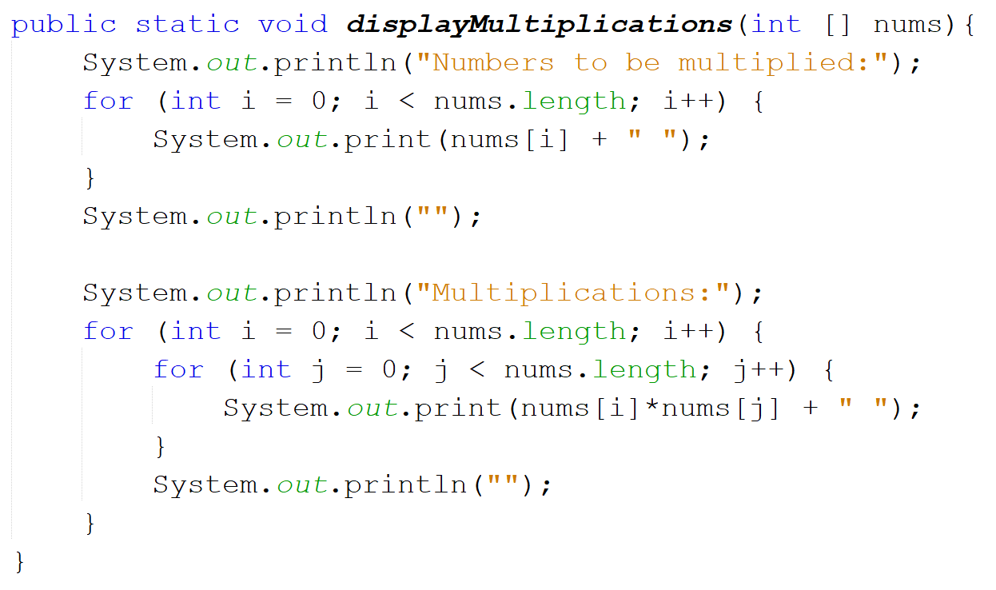
Rule 4) Calculating…
In this example, we have a single loop and a nested loop
Single loop cost: O(n)
Nested loop cost: (O(n²))
Overall cost before eliminating non-dominant: O(n + n²)
After we eliminate: O(n²)
n is the smaller of the two components, it has less of an impact

Slide 14
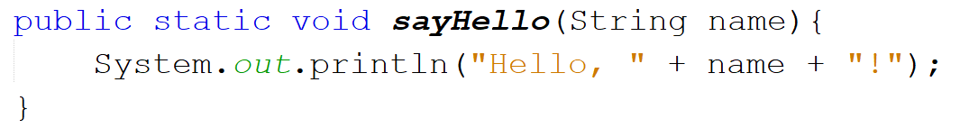
Putting the Rules into Practice: Some Worked Examples
Easy one to start!
What is the order of this piece of code:
Single line of code that does not repeat = O(1)
Final Big O value: O(1)

Slide 15
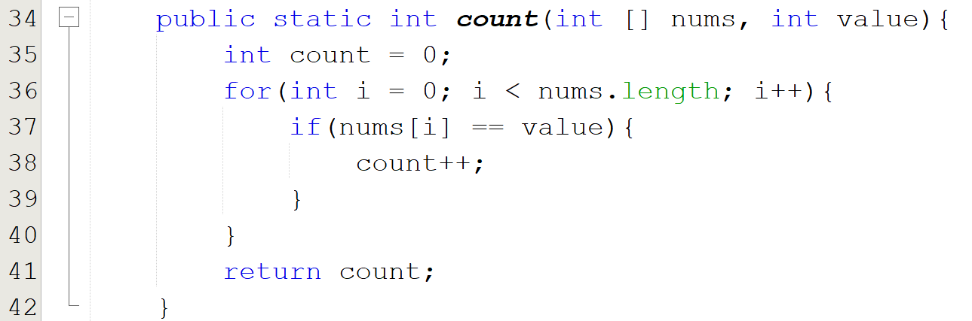
Putting the Rules into Practice: Some Worked Examples
What is the order of this piece of code:
Line 35 = O(1)
Line 36 = O(n)
Line 37 = O(n)
Line 38 = O(n)
Line 41 = O(1)
Initial total: O(1 + n + n + n + 1) = O(3n + 2)
After removing constants: O(n)
No constant multipliers – remove the 3 coefficient
No constant values – remove the 2

Slide 16
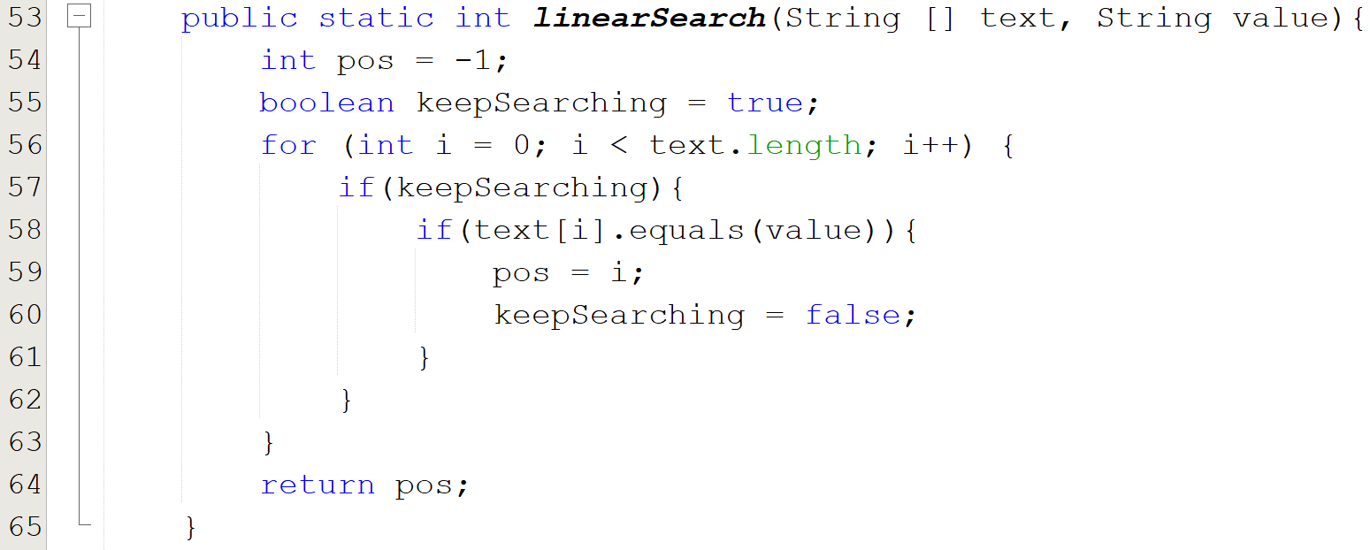
Putting the Rules into Practice: Some Worked Examples
What is the order of this piece of code:
Line 54 = O(1)
Line 55 = O(1)
Line 56 = O(n)
Line 57 = O(n)
Line 58 = O(n)
Line 59 = O(n)
Line 60 = O(n)
Line 64 = O(1)
Linear search – Approach A!
Initial total: O(1 + 1 + n + n + n + n + n + 1) = O(5n + 3)
After removing constants: O(n)
Same as previous example, remove the multiplier and the constant terms

Slide 17
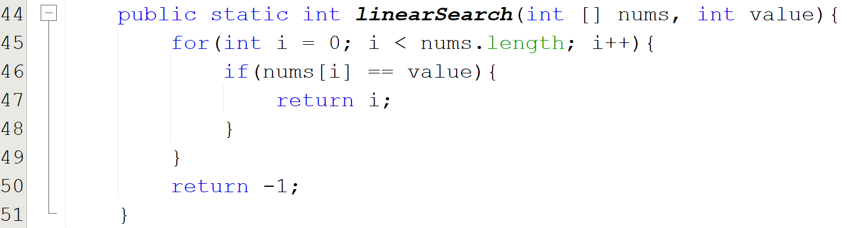
Putting the Rules into Practice: Some Worked Examples
What is the order of this piece of code:
Line 45 = O(n)
Line 46 = O(n)
Line 47 = O(1)
Line 50 = O(1)
Linear search – Approach B!
Initial total: O(n + n + 1 + 1) = O(2n + 2)
After removing constants: O(n)
Same as previous example, remove the multiplier and the constant terms
However, what can we say about the BEST case here?

Slide 18
What About Best Case?
Big O notation calculates the WORST possible performance for an algorithm
We’ve seen two versions of linear search – both have a Big O of O(n), but this is the cost for the worst cases:
If the element isn’t in the array at all
If the element is in the very last slot of the array
What if the element is in the very first slot?
What if the array is empty?

Slide 19
Linear Search A: Best Case Performance Empty Array
When the array is empty:
Line 54 = O(1)
Line 55 = O(1)
Line 64 = O(1)
Linear search – Approach A!
Total: O(1 + 1 + 1) = O(3)

Slide 20
Linear Search B: Best Case Performance Empty Array
When the array is empty:
Line 45 = O(1)
Line 50 = O(1)
Total: O(1 + 1) = O(2)
Not much of a difference between A and B here

Slide 21
Linear Search A: Best Case Performance Found in First Slot
When the match is found in the first slot of the array:
Line 54 = O(1)
Line 55 = O(1)
Line 56 = O(n)
Line 57 = O(n)
Line 58 = O(1)
Line 59 = O(1)
Line 60 = O(1)
Line 64 = O(1)
Linear search – Approach A!
Total: O(1 + 1 + n + n + 1 + 1 + 1 + 1) = O(2n + 6)

Slide 22
Linear Search B: Best Case Performance
When the match is found in the first slot of the array:
Line 45 = O(1)
Line 46 = O(1)
Line 47 = O(1)
Total: O(1 + 1 + 1) = O(3)
MASSIVE difference here!

Slide 23
The Limitation of Only Considering Big O
If you only look at the Big O, you miss out on some very important information!
linearSearch versions A and B both have order of n (i.e. O(n))
If we look at the bigger picture and consider the best case scenario where there is data to work with:
linearSearch A has best case of O(2n+6)
linearSearch B has best case of O(3)!

